Slide 1
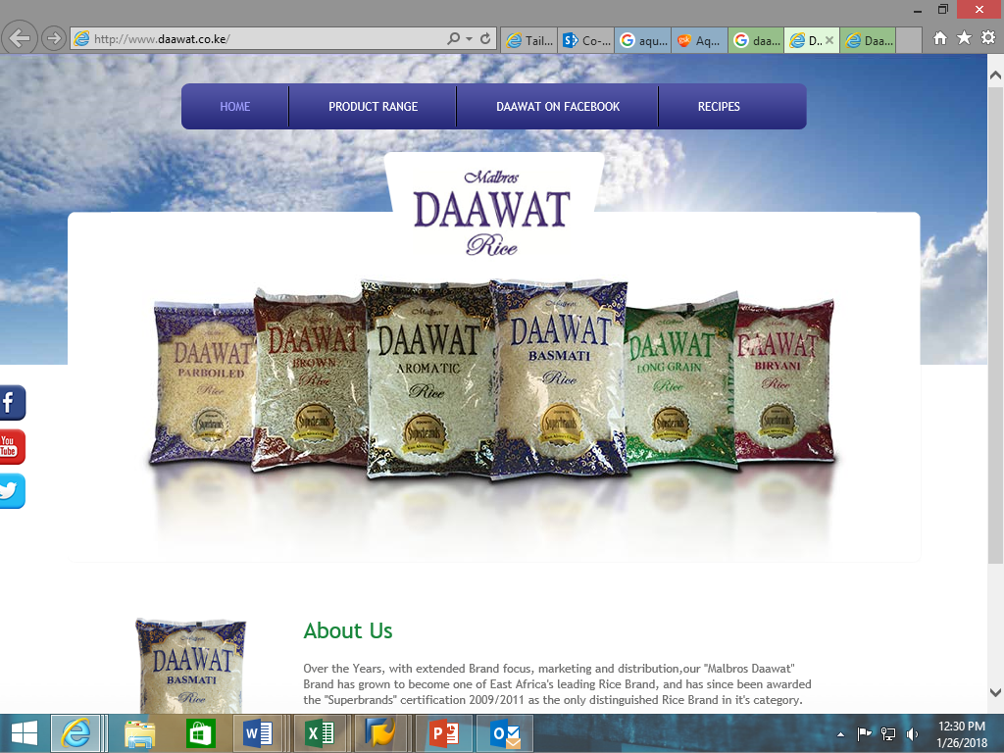
Re-brand Strategy

Slide 2
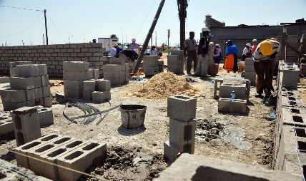
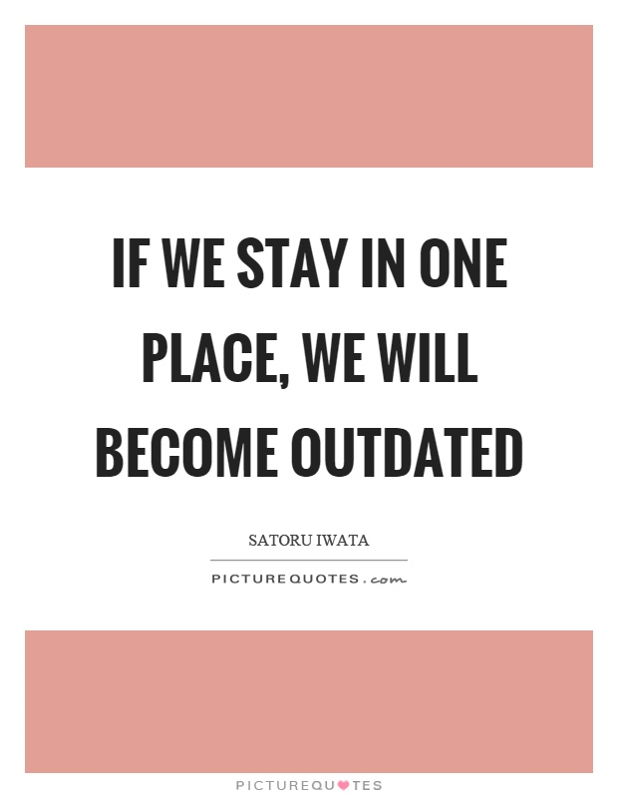
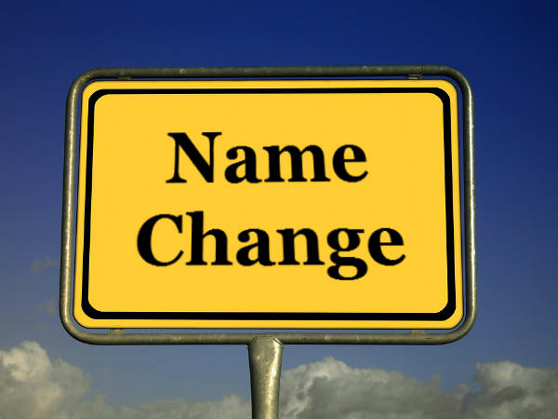
Why the Re-brand?
The Snag
In Kenya, when you hear the word Mjengo, what comes to mind?
The Solution
Company name change
Revitalize the brand identity
Integrate company products

Slide 3
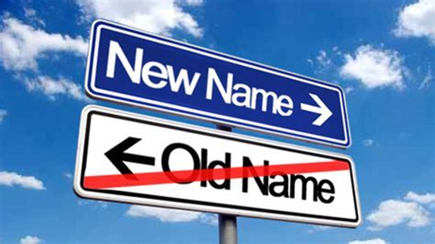
What will rebrand involve?
Propose change of logo to reflect new organization name
Rebranding of all organization products and packaging with new identity

Slide 4
Brand Identity
Signature
Logo/Brandmark
Second Line Logo
Rice – to represent the Daawat rice brands.
Pasta – to represent the Daawat pasta range
Biscuits – to represent the Nu-Vita brand of biscuits
Typography
Daawat Kenya Limited
Main Name: Free Sans Bold – Size 32
Bold – strength, power, stability, security
“Rice. Pasta. Biscuits”
Second Line: French Script – Size 18
Script – formal, refined, elegance, prestige

Slide 5
Proposed Corporate Colors
Blue/Indigo
Gold
This strategy proposes Blue-Indigo as the main corporate color with a ring of gold on the word mark.
Brand Tones
Confident – “crafted to perfection”
Friendly – “no restriction – everyone’s invited to Daawat”
Conversational – posts on social media.
Optimistic – “transforming every meal into a feast”
Language
Logo second line: Formal
Individual brands taglines: moderately informal

Slide 6
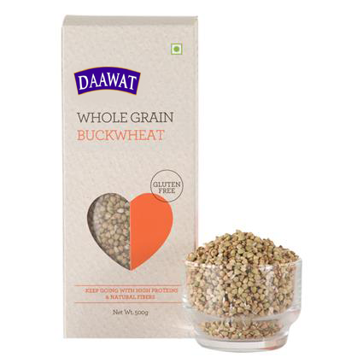
Brand Image
Brand image is the idea of the brand that people develop in their minds when in contact with the brand.
The new name and logo will put more emphasis on the Daawat range of products which is different from the construction image the previous name had.

Slide 7
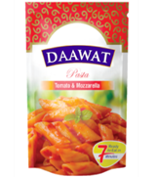
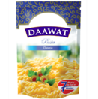
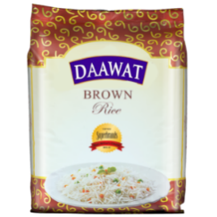
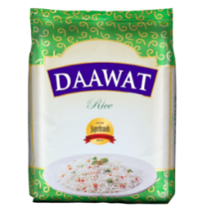
Brand Differentiation
Brand differentiation is the positioning of your brand against others in a meaningful way that matters to consumers. Each person values factors that differentiate one brand from the next in their own ways.
Number of products per brand in the Daawat product range.
Rice – Nonaromatic (6), Aromatic (5)
different from competitor brands.
Biscuits – 9 brands (offering different flavors)
Spaghetti & Pasta – 8 (flavored & unflavored)
Taste quality – more flavors with local appeal
Nutritional value – health consciousness, especially in the brown rice category
Packaging – distinctive attractive packaging

Slide 8
Brand Equity
Intangible Brand Equity
 | Brand Distinction | Brand Essence | Brand Personality | Brand Character
Daawat Rice & 224 | Offers variety of rice products | Offers choice of brands with varying nutritional value | Reliable Dependable | Quality rice choices
Spaghetti | Variety of 3 choices sold at lower prices | Price-savvy comparable to competition | Price-friendly yet good quality | No gimmick, honest savings
Pasta | Available in flavored and non-flavored products | Flavored pasta targets adventurous cooks willing to try something different | Engaging, especially in recipe trials | Creativity in meals
Biscuits | Quality crunchy biscuits affordable by all | Tasty, crunch | Youthful Happy | Variety of tasty biscuits
Corn Puffs | New and targeted to children | Offering only two flavors now | New | Requires further innovation & research on acceptability.

Slide 9
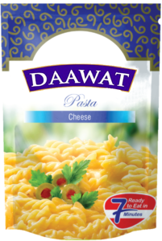
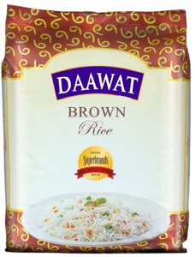
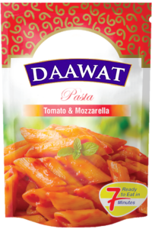
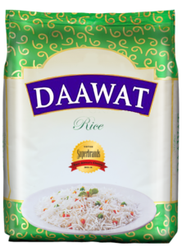
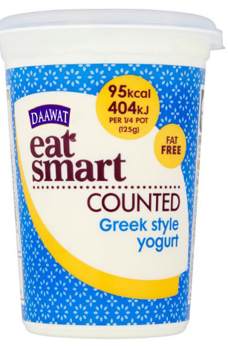
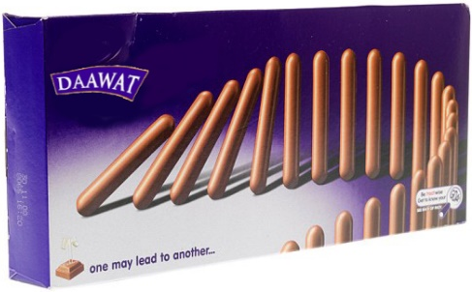
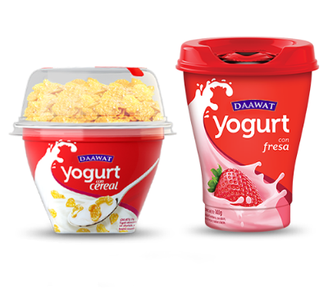
Brand Personality
A set of human characteristics that are attributed to a brand name. A brand personality is something to which the consumer can relate, and an effective brand will increase its brand equity by having a consistent set of traits.
Daawat’s Personality
Optimal Choice
Diversity

Slide 10
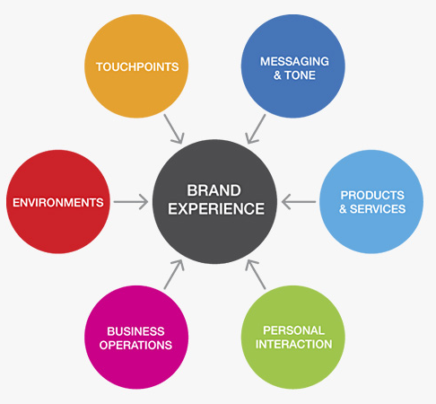
Brand Experience
Brand experience is a term used to describe the total impression of a potential consumer of a brand.
There is no physical entity that can be identified as brand experience.
Brand experience refers to the total experience of the brand, which may come from advertisements, actual use, reporting, or other interactions with the brand.
This strategy will seek to harness all the touchpoints to encourage customer loyalty and preference of the brand.

Slide 11
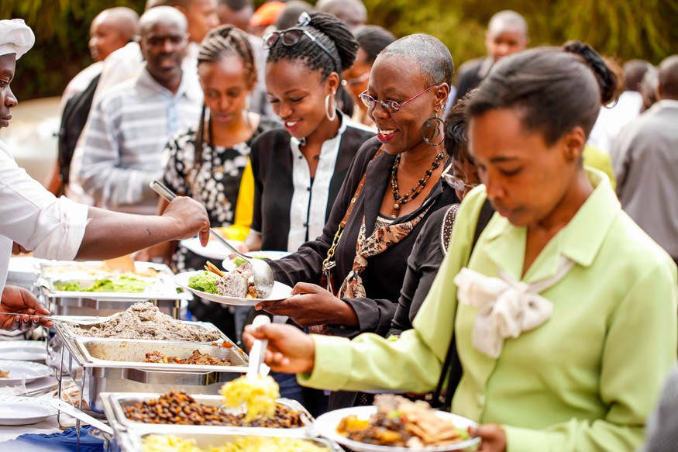
Brand Positioning
Positioning is a marketing strategy that aims to make a brand occupy a distinct position, relative to competing brands, in the mind of the customer.
Having a party? Think Daawat!
Daawat Kenya is your dependable partner! Daawat always delivers on its promise of quality.

Slide 12
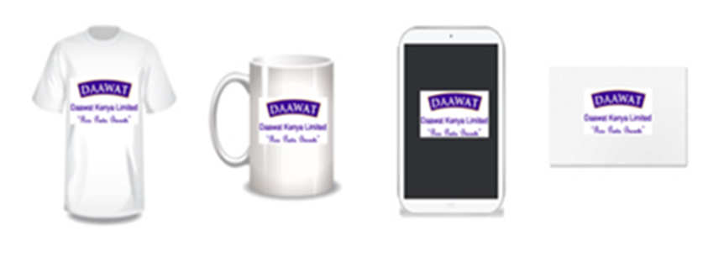
Brand Touch Points
Website/Favicon
Social Media Platforms
Company Products

